Slide 1
Spark Structured Streaming - Programming Model
Pravin Y Pawar

Slide 2
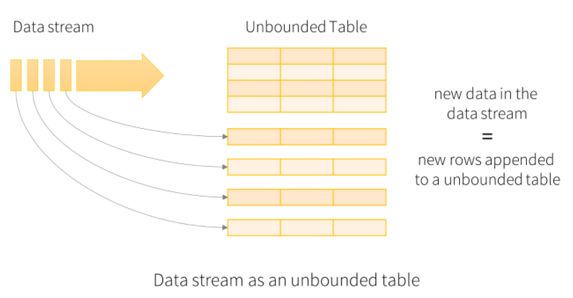
Programming Model – Unbounded Table
Input representation
The key idea is to treat a live data stream as a table that is being continuously appended
Leads to a new stream processing model that is very similar to a batch processing model
Express streaming computation as standard batch-like query as on a static table,
Spark runs it as an incremental query on the unbounded input table
Consider the input data stream as the “Input Table”. Every data item that is arriving on the stream is like a new row being appended to the Input Table.

Slide 3
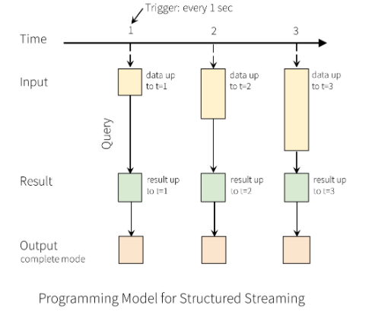
Programming Model – Query
Processing
A query on the input will generate the “Result Table”
Every trigger interval (say, every 1 second), new rows get appended to the Input Table
which eventually updates the Result Table
Whenever the result table gets updated, we would want to write the changed result rows to an external sink

Slide 4
Programming Model – Output modes
Written out to the external storage
The “Output” is defined as what gets written out to the external storage with different modes
Complete Mode
The entire updated Result Table will be written to the external storage
up to the storage connector to decide how to handle writing of the entire table
Append Mode
Only the new rows appended in the Result Table since the last trigger will be written to the external storage
applicable only on the queries where existing rows in the Result Table are not expected to change
Update Mode
Only the rows that were updated in the Result Table since the last trigger will be written to the external storage
different from the Complete Mode in that this mode only outputs the rows that have changed since the last trigger
If the query doesn’t contain aggregations, it will be equivalent to Append mode
Each mode is applicable on certain types of queries

Slide 5
Model Details
Descriptive
Conceptually, Structured Streaming treats all the data arriving as an unbounded input table
Each new item in the stream is like a row appended to the input table
Won’t actually retain all the input, but results will be equivalent to having all of it and running a batch job
The developer then defines a query on this input table
as if it were a static table, to compute a final result table that will be written to an output sink
Incrementalization
Spark automatically converts this batch-like query to a streaming execution plan
Spark figures out what state needs to be maintained to update the result each time a record arrives
Finally, developers specify triggers to control when to update the results
Each time a trigger fires, Spark checks for new data (new row in the input table), and incrementally updates the result

Slide 6
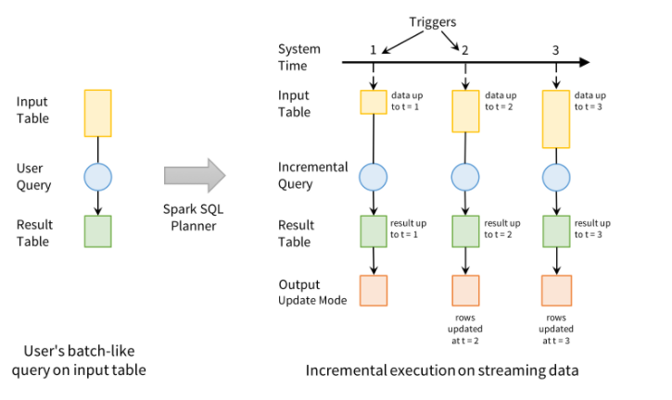
Model Details
Pictorial

Slide 7
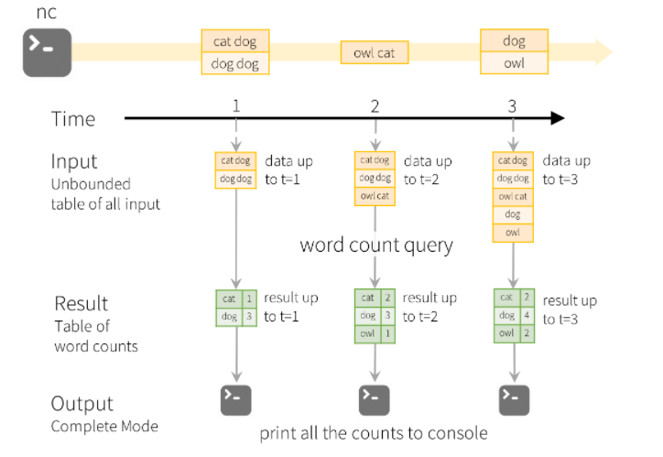
Example – Complete mode output
Streaming WordCount example

Slide 8
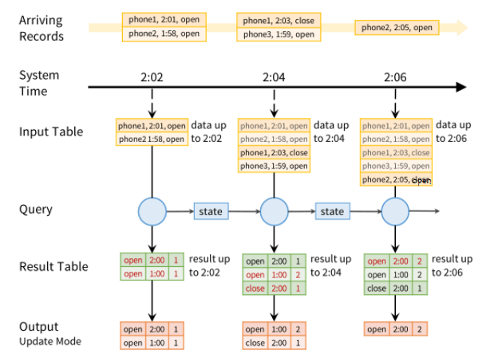
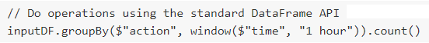
Example – Update mode output
Mobile monitoring application

Slide 9
Input Sources
built-in sources
File source
Reads files written in a directory as a stream of data
Files will be processed in the order of file modification time
Supported file formats are text, CSV, JSON, ORC, Parquet
Kafka source
Reads data from Kafka
compatible with Kafka broker versions 0.10.0 or higher
Socket source (for testing)
Reads UTF8 text data from a socket connection
The listening server socket is at the driver
should be used only for testing as this does not provide end-to-end fault-tolerance guarantees
Rate source (for testing)
Generates data at the specified number of rows per second, each output row contains a timestamp and value
intended for testing and benchmarking

Slide 10
Sinks
built-in output sinks
File sink
Stores the output to a directory
Kafka sink
Stores the output to one or more topics in Kafka
Foreach sink
Runs arbitrary computation on the records in the output
Console sink (for debugging)
Prints the output to the console/stdout every time there is a trigger
Both, Append and Complete output modes, are supported
Memory sink (for debugging)
The output is stored in memory as an in-memory table
Both, Append and Complete output modes, are supported

Slide 11
Thank You!
Reference:
Stream Processing with Apache Spark – Maas & Garillot
Spark Structured Streaming documentation
Spark Structured Streaming A new high-level API for streaming
by Matei Zaharia, Tathagata Das, Michael Armbrust and Reynold Xin
In our next session:

